Slide 1


Delivering Data Warehouses on Microsoft SQL Server
Anil Mahadev
Cloud Solutions Architect
WhereScape USA

Slide 2
Agenda
The Datawarehouse Landscape
Data Warehouse Lifecycle
WhereScape Architecture
Demo of building a Simple Dimension
Q&A
The Datawarehouse Landscape
Datawarehousing Lifecycle
WhereScape Architecture
Demo of building a Simple Dimension
Q&A

Slide 3
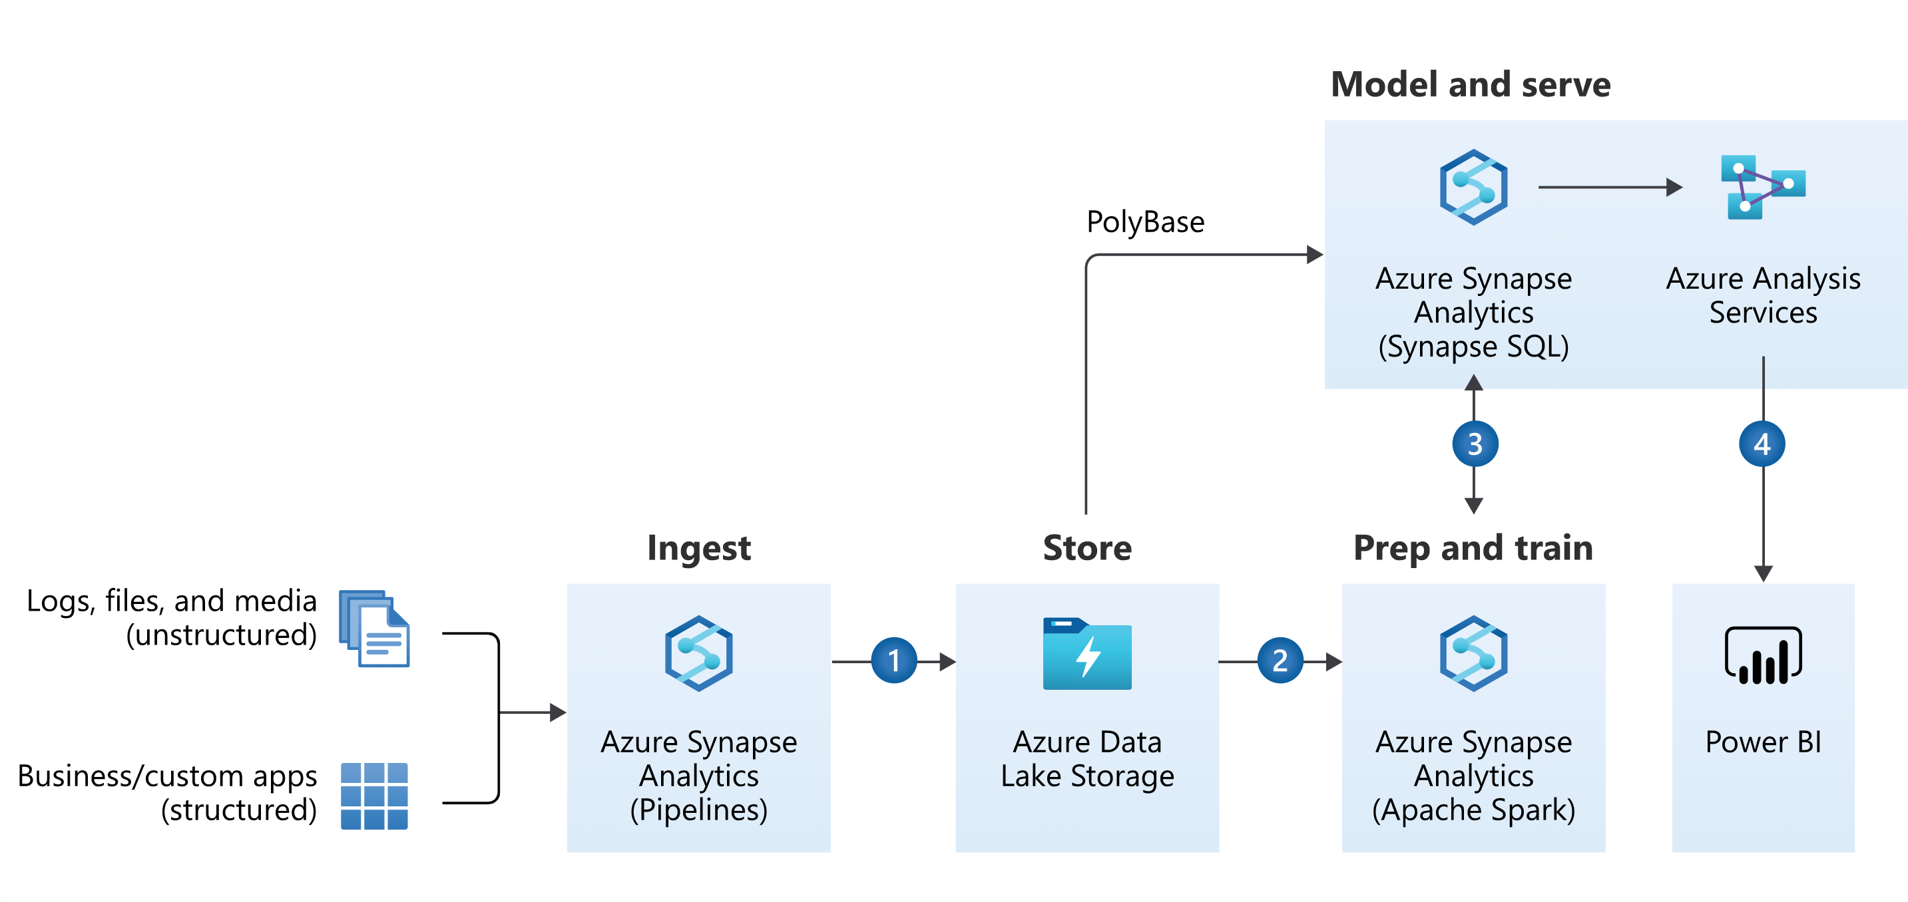
The Modern Data Warehouse

Slide 4
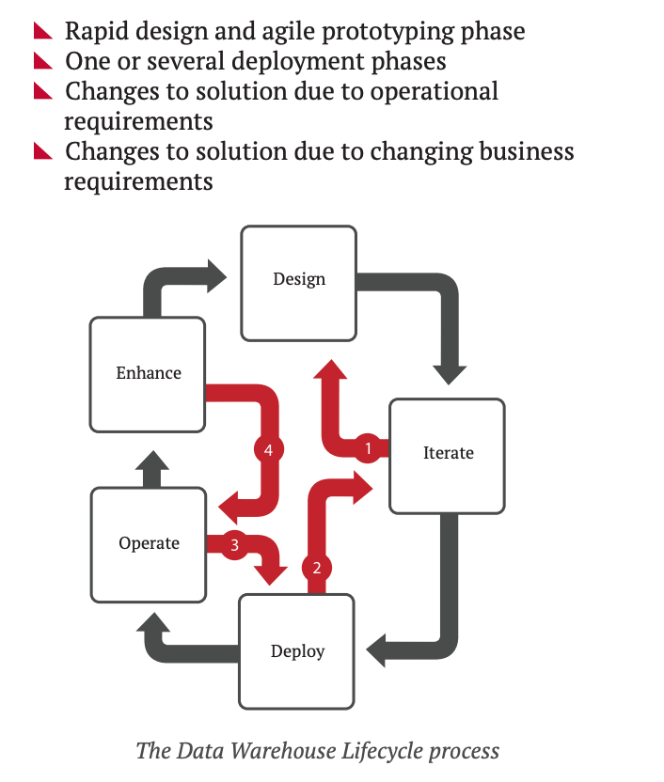
Data Warehouse Lifecycle

Slide 5
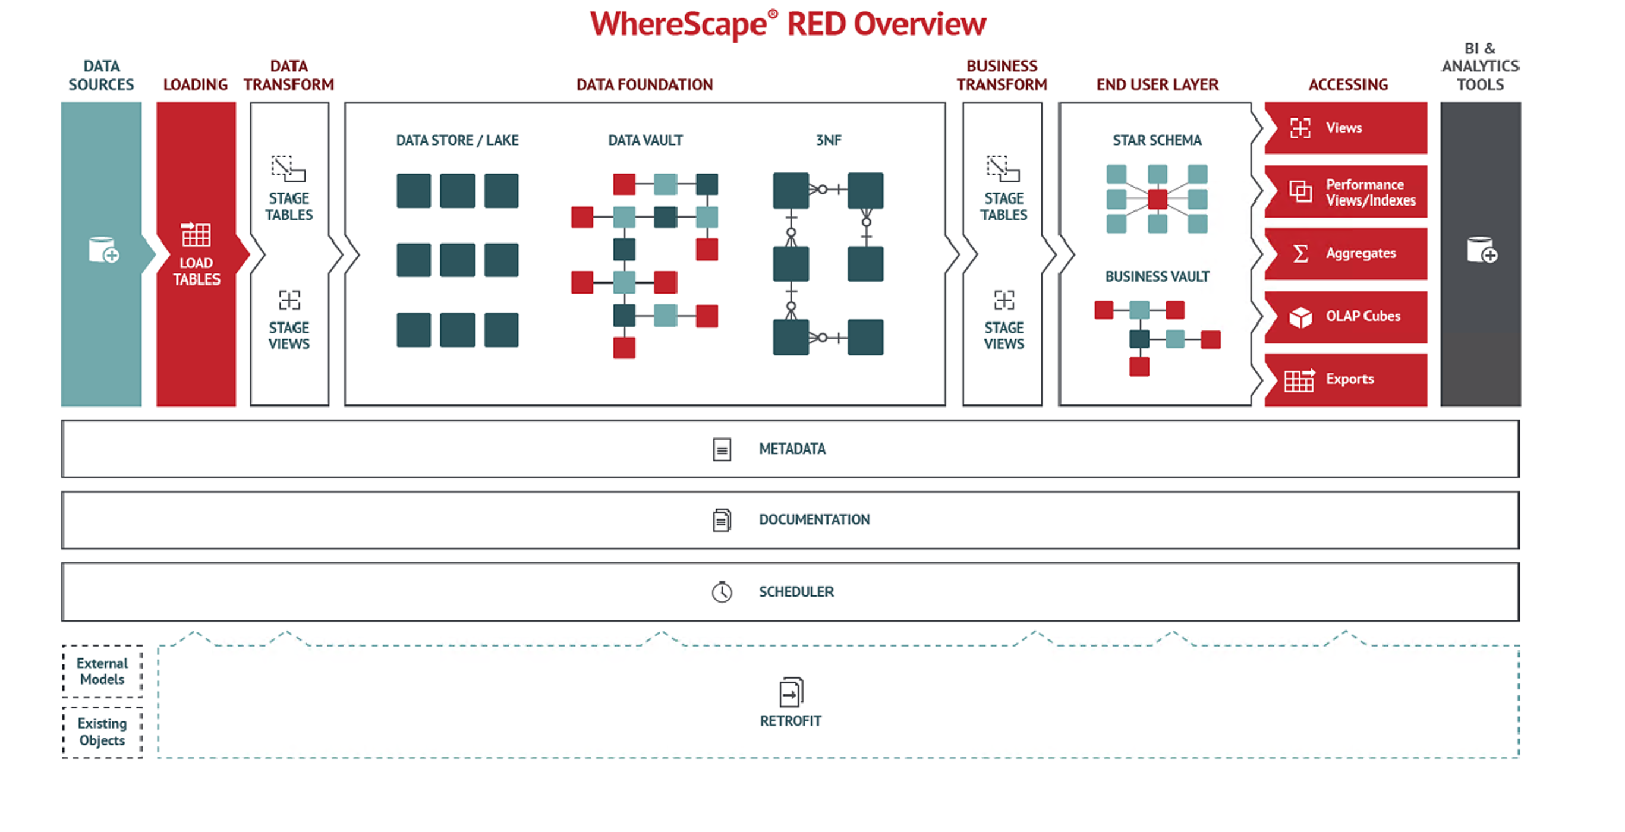
WhereScape Architecture

Slide 7
Demo Time!
The Datawarehouse Landscape
Datawarehousing Lifecycle
WhereScape Architecture
Demo of building a Simple Dimension
Q&A

Slide 8
Questions?
Marketing@WhereScape.com
Request a Demo: wherescape.com/request-a-demo/
The Datawarehouse Landscape
Datawarehousing Lifecycle
WhereScape Architecture
Demo of building a Simple Dimension
Q&A

